Slide 1
A Visual Search Engine for
Ecom/Retail using Deep Learning
Developed by : Abin Abraham Oommen
Guided by : Dr. Thomas Koickal
www.applexus.com

Slide 2
Introduction
Block diagram
Block diagram description
Business use case
Product image database
Image preprocessing
Deep learning model
Product Identification
HOG feature extraction
Feature dataset
Similarity Measurement
Results
Conclusion and future scope
TOPICS
DECEMBER 2017

Slide 3
Introduction
The system automatically identifies the object from its image and finds the most similar products using deep learning and a visual search on the product database
We need to just upload the product image and our system will display its most similar products and their details
The system works by comparing the input image with all the images in product database and selects the most similar images

Slide 4
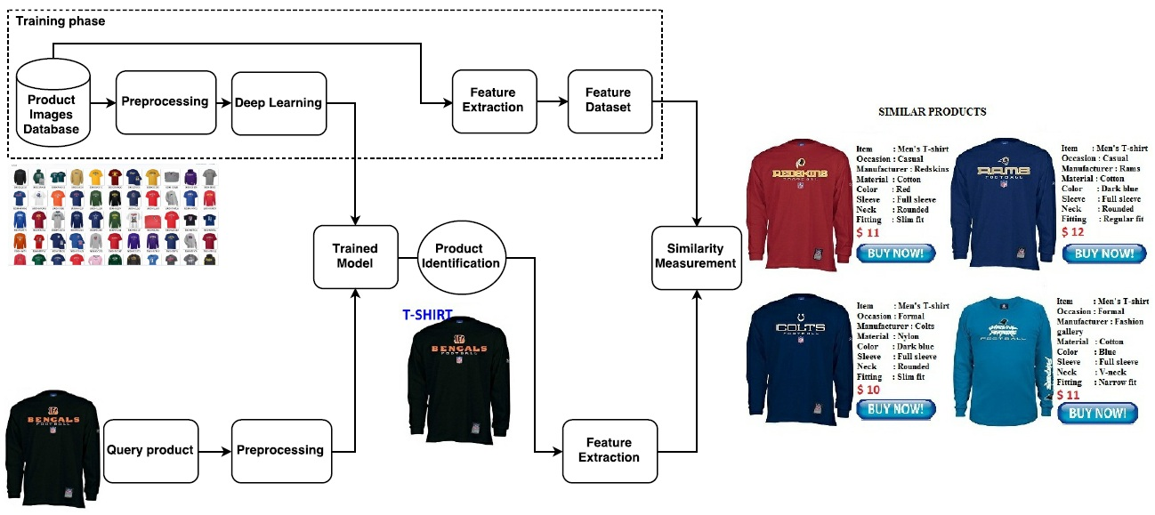
Block Diagram

Slide 5
Block Diagram Description
The system consists of two main processes
First is to upload a product image and its category is identified using deep learning
If the identified product category is not in the database it shows as not available
If the identified product category is in the database, Query image’s feature calculated and is compared with the database to find most similar images
Finally it displays the most similar products and its descriptions

Slide 6
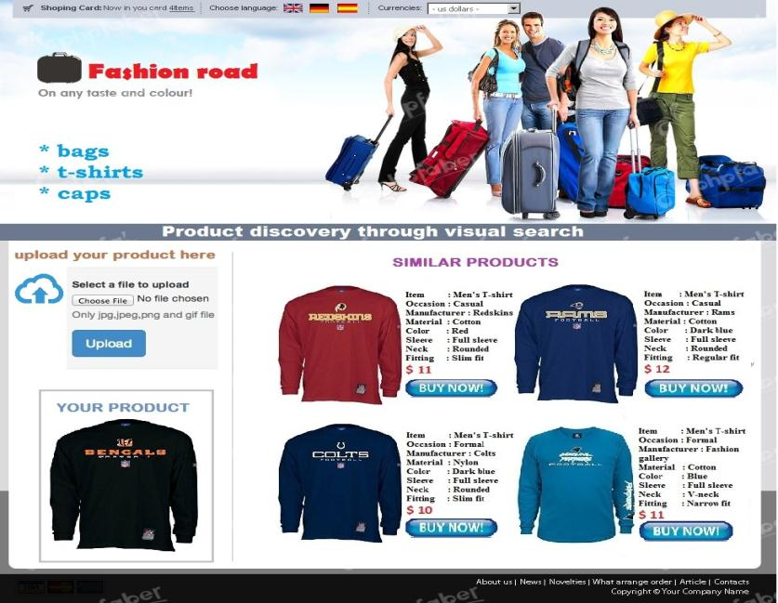
Business use case
Ecom website with product discovery

Slide 7
Product Images Database
Database consists of the images we have collected for product search
All the product images are saved on the same directory or server
All the images in the database should be of same type(JPG,PNG,BMP,etc) but can have different sizes
DECEMBER 2017

Slide 8

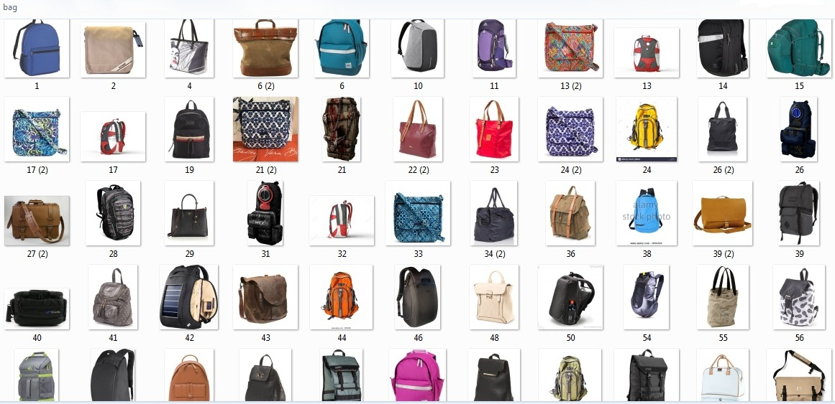
Product Images Database
Example for Bag Database – 1784 items

Slide 9
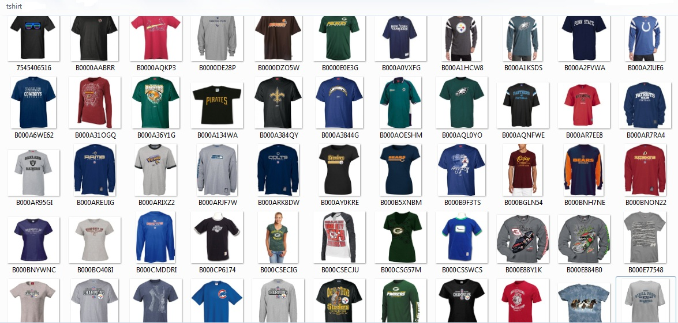
Product Images Database
Example for T-shirt Database – 18325 items

Slide 10
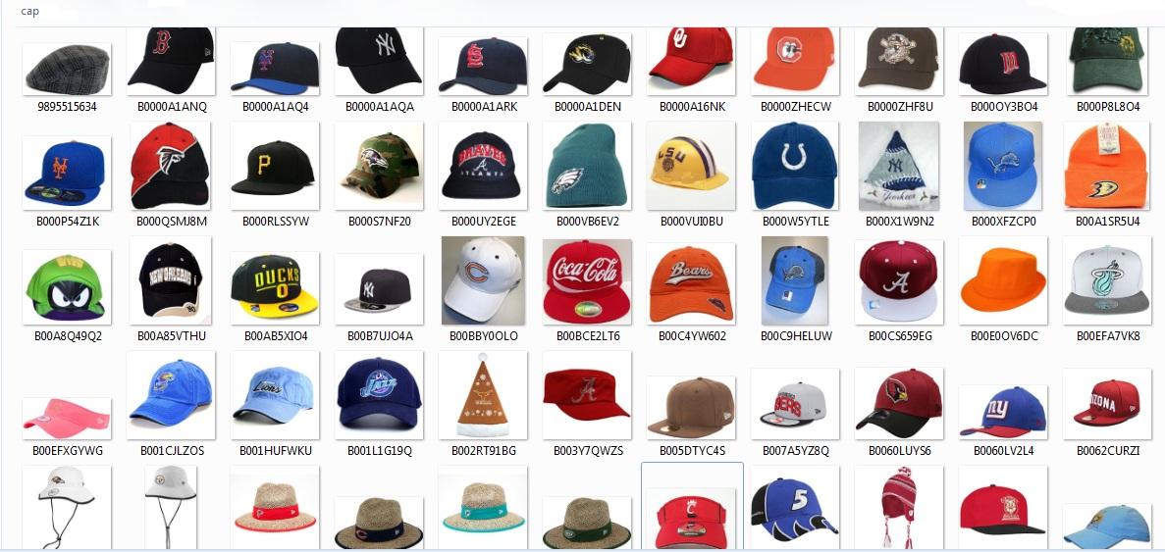
Product Images Database
Example for Cap Database – 11862 items

Slide 11
Image Pre-processing
Database consists of RGB images of any specific size
We converts the image into a square size but preserves the shape of the image
It is done by padding extra matrices row wise or column wise to the image matrix so that row and column sizes will becomes equal
If image width is greater, then append white images to the upper and bottom part of the image so that it will become square
If image height is greater, then append white images to the left and right part of the image so that it will become square
Finally, convert the image into a common square size and converts the RGB image into a grayscale image
DECEMBER 2017

Slide 12
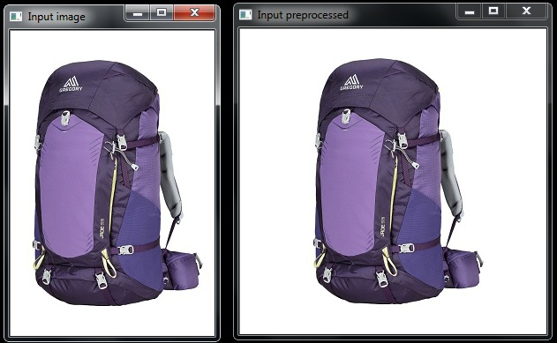
Image Pre-processing
Example for preprocessing image horizontal wise

Slide 13
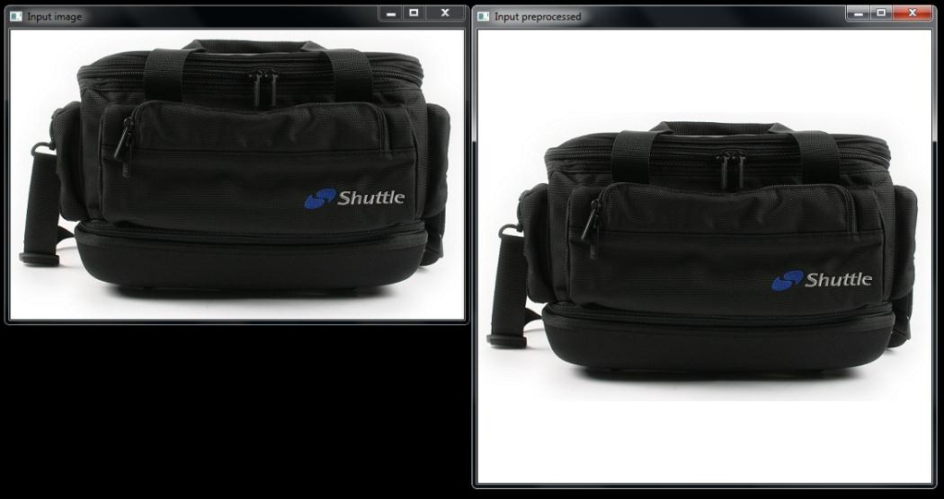
Image Pre-processing
Example for preprocessing image vertical wise

Slide 14
Deep Learning Model
ResNet50 is a highly accurate deep learning model published by Microsoft research.
Model size is small because it uses global average pooling instead of fully connected layers
Its memory cost and accuracy exceeds VGG and GoogleNet
Training is easier than simple deep CNN & the problem of degrading accuracy is solved

Slide 15
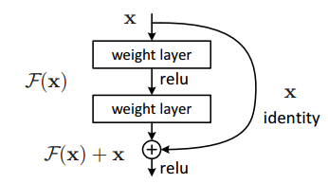
Deep Learning Model
50 layers of similar blocks with "bypass connections" shown as the x identity below

Slide 16
Deep Learning Model
Residual learning
Here learning some residuals instead of learning features
Residual is simply subtraction of feature learned from input of the layer
It is done using shortcut connections. ie, connecting input of nth layer to (n+x) th layer.
Image is resized into the size of 224*224 which is the required input dimension for ResNet model. So image size becomes 224*224*3.

Slide 17
Product Identification
Here we pass the preprocessed image to the model and get it predicted
These predictions are actually a NumPy array with n entries and the predicted probabilities associated with each class in the dataset.
Then we find the maximum probability value and its corresponding class
Product name corresponding to the obtained class is our identification result
If the product identified is out of our collection, then it will be shown as not available

Slide 18
Hog Feature Extraction
Feature descriptor is a representation of an image that simplifies the image by extracting useful information and throwing away extraneous information.
HOG(Histogram of Oriented Gradients) feature detector extracts information on the shape and intensity variation of the object
In HOG feature descriptor, the distribution (histograms) of directions of gradients ( oriented gradients ) are used as features.
Gradients ( x and y derivatives ) of an image are useful because the magnitude of gradients is large around edges and corners and that pack in a lot more information about object shape than flat regions.
As the name indicates, HOG finds the histograms of gradients of image blocks and combines all the histograms to get the final descriptor.

Slide 19
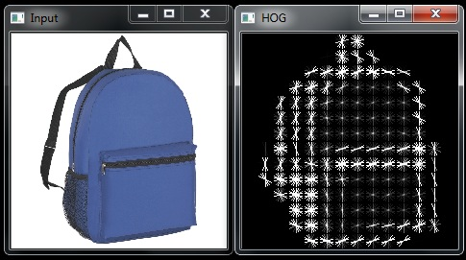
Hog Feature Extraction
Example for a product and its HOG image

Slide 20
Feature Dataset
HOG feature of all the images in the database is calculated.
All the HOG features are combined vertically to get a matrix which can be called as feature dataset.
If we have 100 images in database and each image has feature of size 1*1500, then we get feature dataset of size 100*1500.

Slide 21
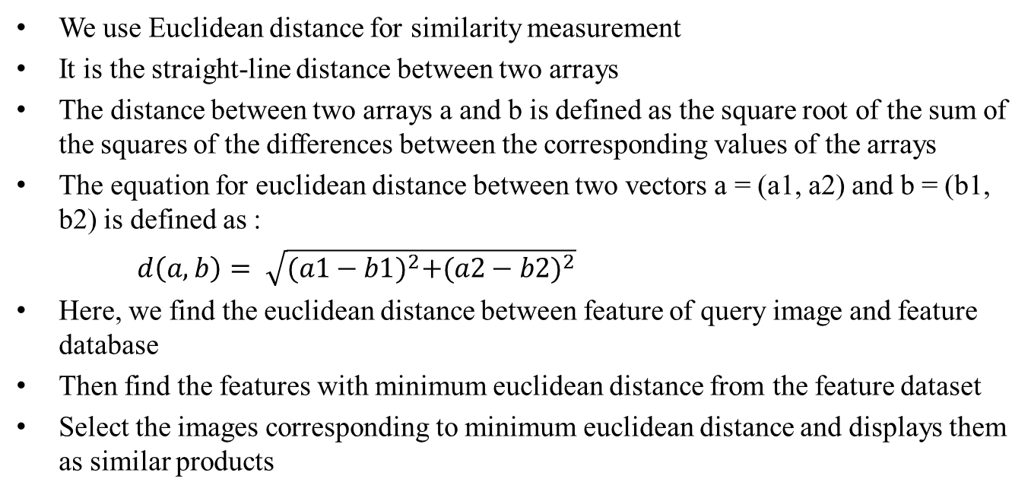
Similarity Measurement
We use Euclidean distance for similarity measurement
It is the straight-line distance between two arrays
The distance between two arrays a and b is defined as the square root of the sum of the squares of the differences between the corresponding values of the arrays
The equation for euclidean distance between two vectors a = (a1, a2) and b = (b1, b2) is defined as :
$d\left(a,b\right)= \sqrt{{(a1−b1)}^{2}+{(a2−b2)}^{2}}$
Here, we find the euclidean distance between feature of query image and feature database
Then find the features with minimum euclidean distance from the feature dataset
Select the images corresponding to minimum euclidean distance and displays them as similar products

Slide 22
Results

Slide 23
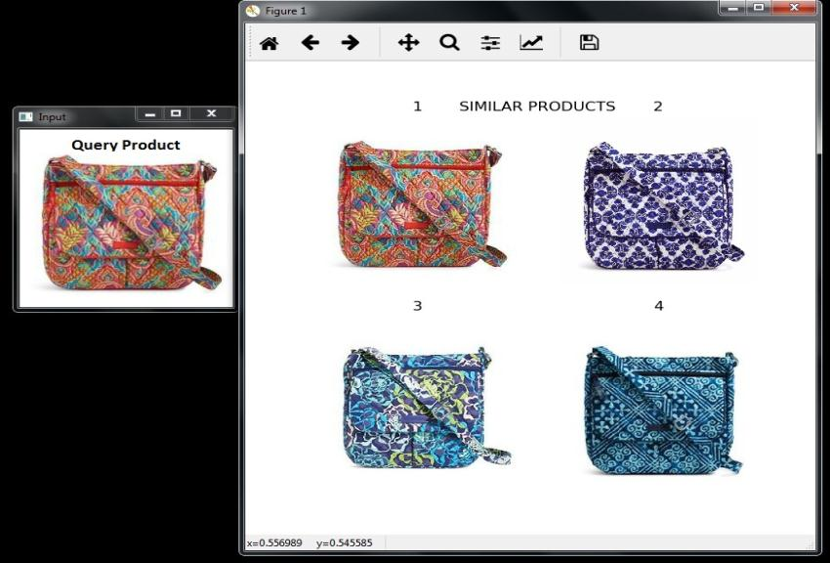
Query product from database
Uploaded image which is either from hard-disk or from camera
Four products which are most similar to the query product

Slide 24
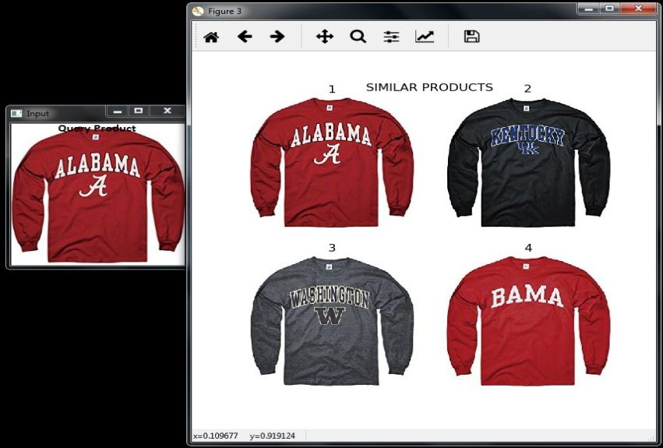
Query product from database
Uploaded image which is either from hard-disk or from camera
Four products which are most similar to the query product

Slide 25
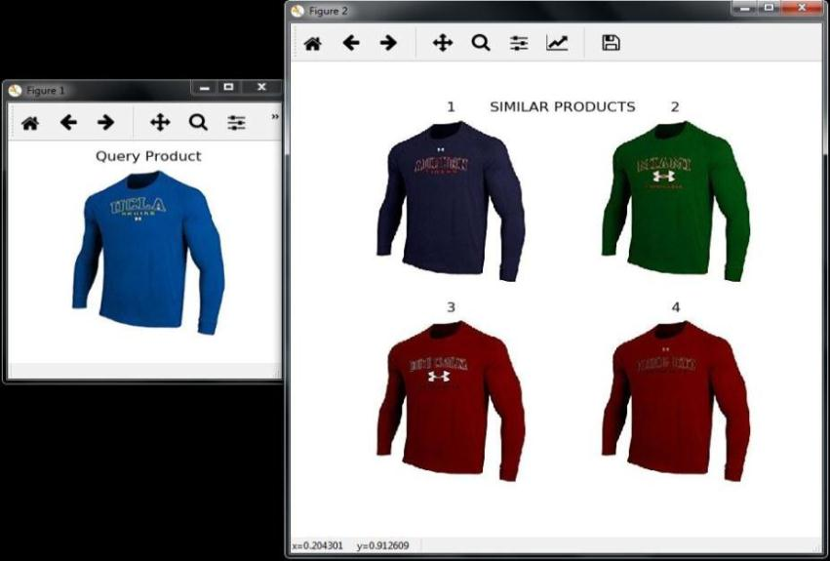
Query product not in database
Uploaded image which is either from hard-disk or from camera
Four products which are most similar to the query product

Slide 26
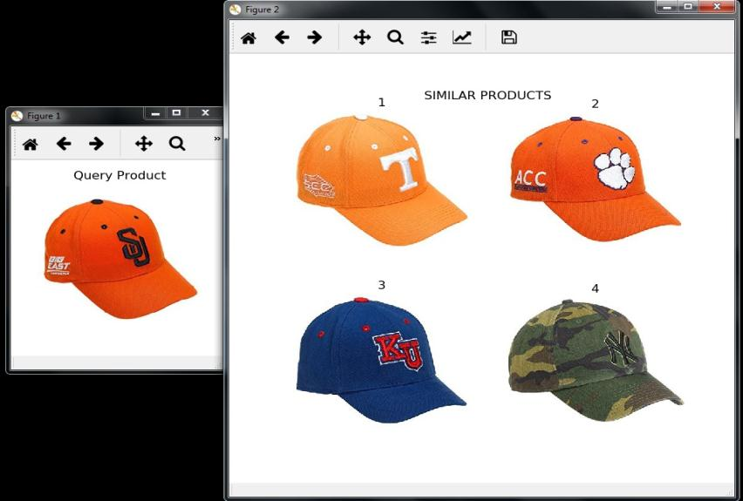
Query product not in database
Uploaded image which is either from hard-disk or from camera
Four products which are most similar to the query product

Slide 27
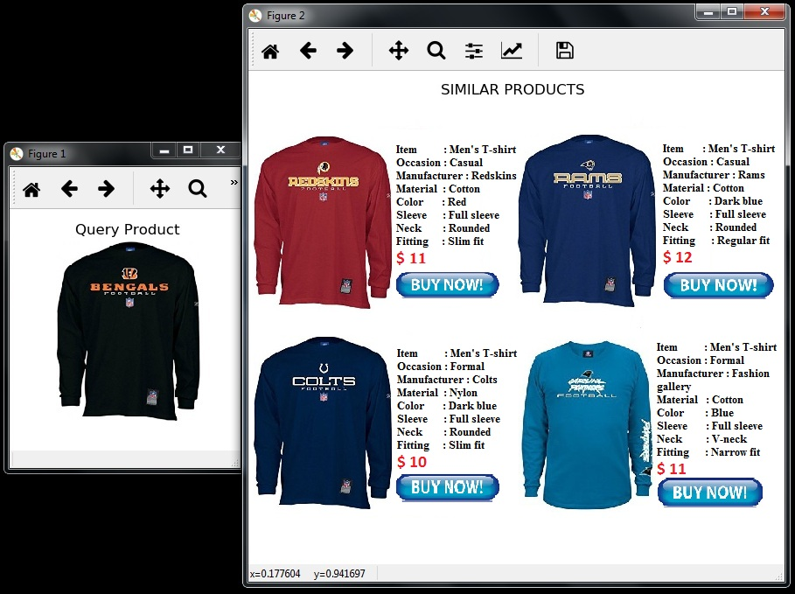
Products with description
Similar T-shirts with its full details are displayed

Slide 28
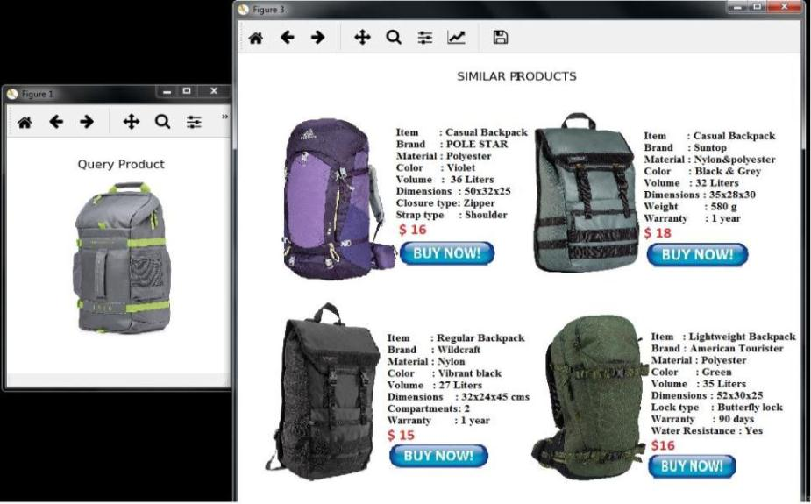
Products with description
Similar bags with its full details are displayed

Slide 29
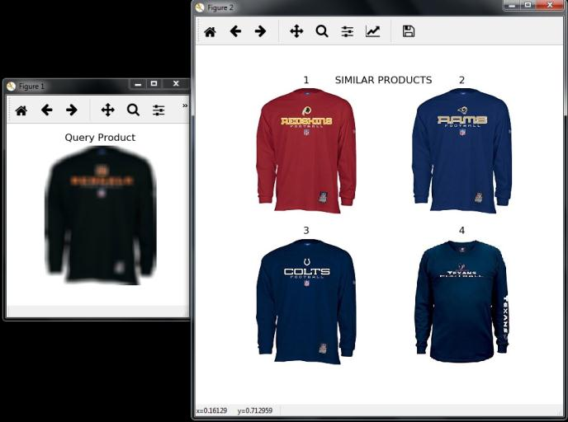
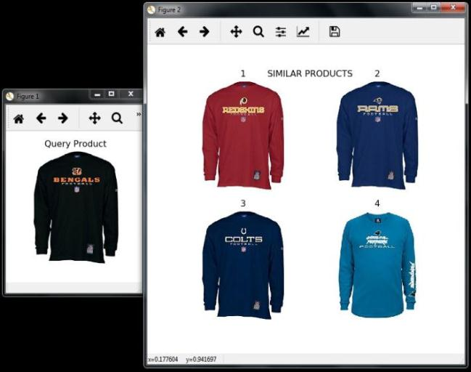
Product with blurred image
Blurred image
Groundtruth
Here we add Gaussian blur to image and got same result as original image

Slide 30
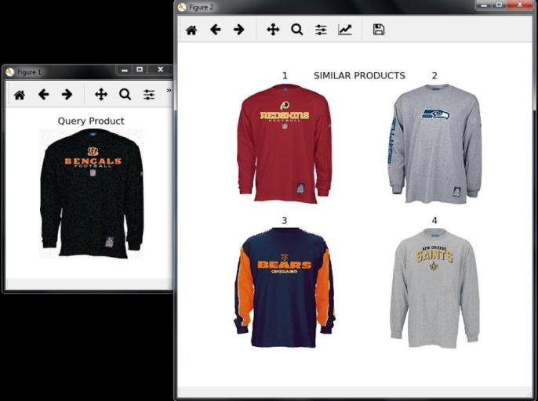
Product with noisy image
Noisy image
Groundtruth
Here we add 15% of Gaussian noise to image and got same result as original image

Slide 31
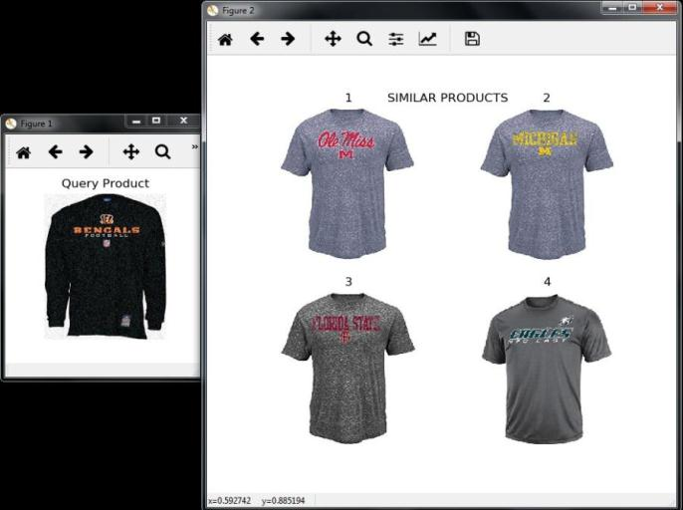
Product with noisy image
Noisy image
Groundtruth
Here we add 25% of Gaussian noise to image and result got changed

Slide 32
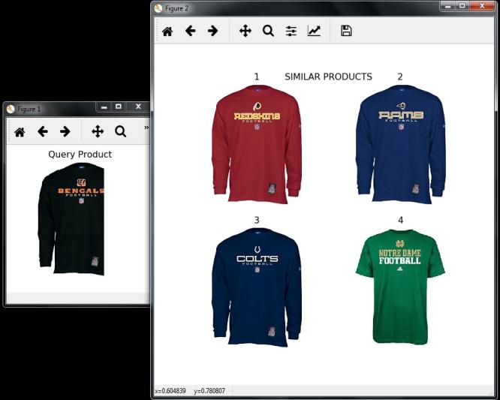
Product with incomplete image
Incomplete image
Groundtruth

Slide 33
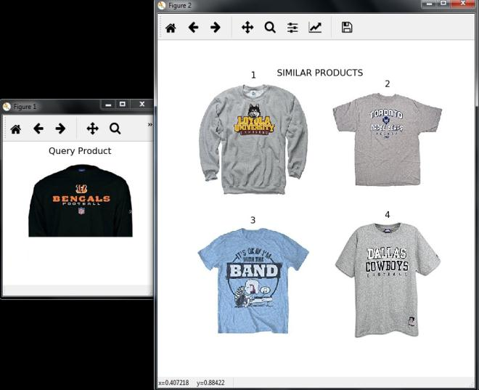
Product with incomplete image
Incomplete image
Groundtruth

Slide 34
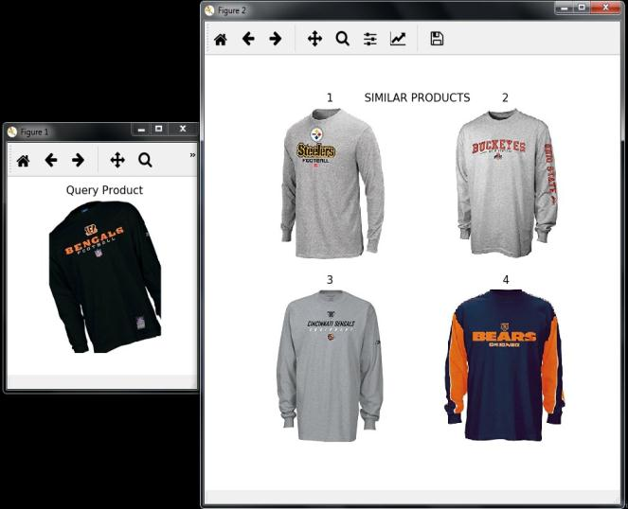
Product with incomplete image
Incomplete image
Groundtruth

Slide 35
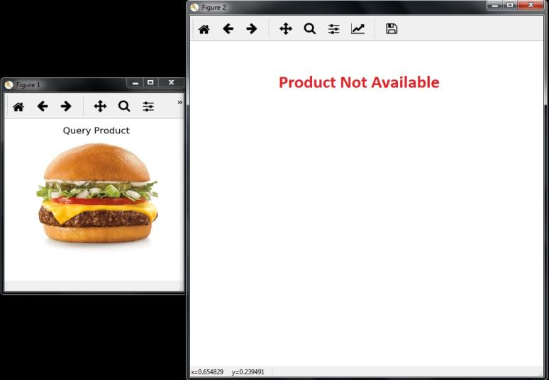
Product of different category
Here the product identified as BURGER and is out of database

Slide 36
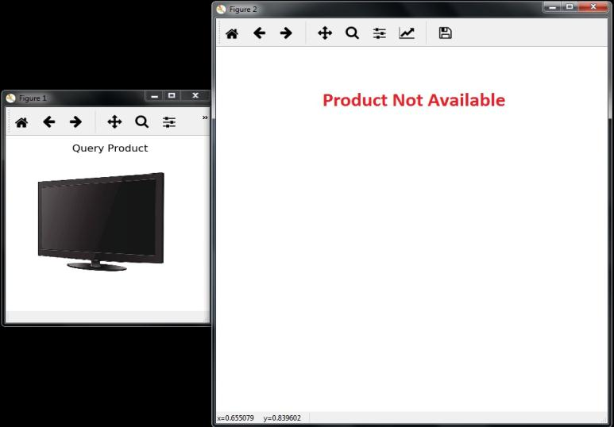
Product of different category
Here the product identified as TELEVISION and is out of database

Slide 37
Conclusions and Future work
The system implements a good method for finding the similar products using deep learning and visual search
The system can be modified by adding additional features such as color features, shape features and texture features.
It can be modified by using deep learning methods for feature extraction
Deep learning training on more products to be performed
Extensive testing to be performed on more product images

Slide 38
Your Phone #
contact@applexus.com

